Slide 1
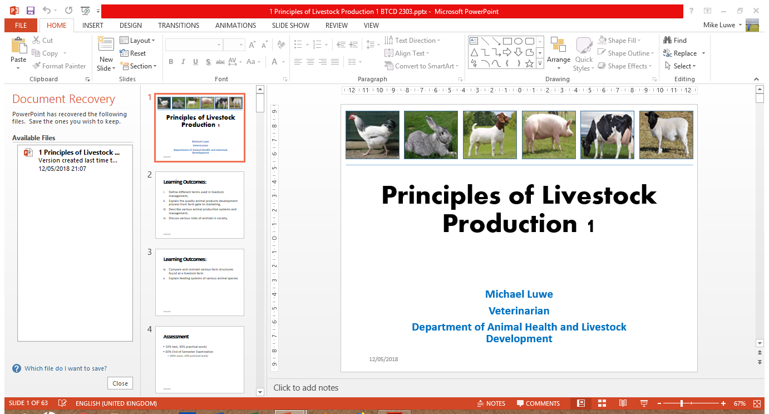
Principles of Livestock Production 1
Michael Luwe
Veterinarian
Department of Animal Health and Livestock Development

Slide 2
Assessment
10% test, 30% practical work)
60% End of Semester Examination
(40% exam, 20% practical work)

Slide 3
Introduction to Livestock Management
Definitions
Livestock are defined as any domestic animals, such as cattle, sheep, goats or pigs, raised for home use or for profit, especially on a farm.
Animal husbandry is the branch of science, which deals with the study of various breeds of domesticated animals and their management for obtaining better products and services from them.
Breed can be defined as an established group of animals having similar general body shape, colour, structure and characters which produce offspring with same characters.

Slide 4
Introduction to Livestock Management
Definitions
Livestock management is the practice of efficient, productive, and ethical care-taking of livestock.
Livestock management can also be defined as the practice that relates to the health, husbandry or biosecurity of livestock during any stage of the livestock’s life, from birth to slaughter, including the transport and holding of livestock.

Slide 5
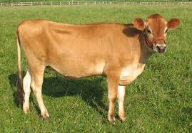
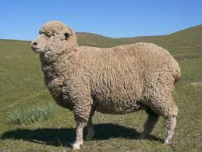
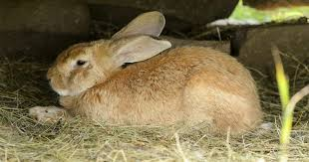
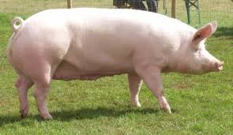
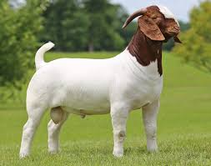
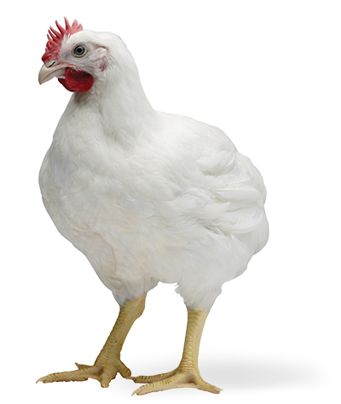
Examples of livestock
Notes:
Livestock (horses included) as opposed to Pets

Slide 6
Farming system is a set of agro-economic activities that are interrelated and interact with themselves in a particular agrarian setting (Sharma et al, 1991).
Integrated farming system (IFS) is a component of farming system research which is aimed at introducing a change in the farming techniques for maximum production – optimum utilisation of resources
Livestock production system is a term used to denote a farming system of interest
Not only for the study of livestock
But also for the purposes of livestock development
Notes:
FS represents an appropriate combination of farm enterprises and the means available to the farmer to raise them for profitability
IFS envisage harnessing the complementarities and synergies aamong different agricultural sub-systems/enterprises and augmenting the total productivity, sustainability and gainful employment.

Slide 7
Classification of Livestock Production Systems based on management
Extensive
The oldest method of rearing animals usually practised by smallholder farmers who are resource poor
Animals are kept on free-range for part or all their production cycle
Low input – low output production system
Highly integrated – crops and livestock and even different breeds or species
Examples are pastoralism, subsistence and ranching
Notes:
Practices usually based on indigenous knowledge

Slide 8
Classification of production Systems based on management
Semi-Intensive
This system combines extensive and intensive systems.
In this system, the farmer provides housing for the animals and allows them to move out to feed on natural vegetation.
Commonly used by small-scale farmers

Slide 9
Classification of production Systems based on management
Intensive
Basically a high input – high output production system with a smaller piece of land being used.
Aim is to achieve maximum profits.
Animals are raised in confinements and feed efficiency is high, thus growth rate is also high.

Slide 10
Classification of production Systems based on economic value
Livestock Production Systems can be classified into two:
Subsistence
Commercial
Livestock Production Systems can either be a mixed crop-livestock system or constitute the whole system

Slide 11
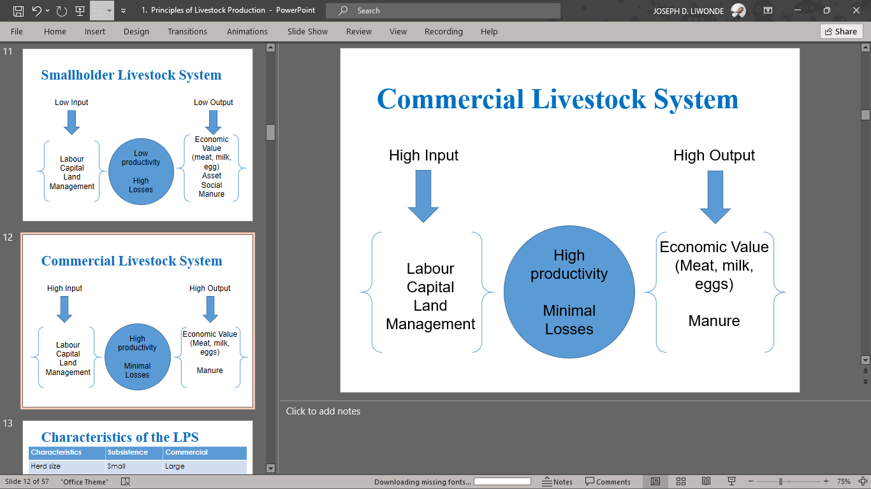

Slide 12
Characteristics of the LPS
Characteristics | Subsistence | Commercial
Herd size | Small | Large
System of Production | Extensive | Intensive
Input | Low | High
Area of production | Rural | Urban and Peri-urban
Uses | Multipurpose | Commercial
Breeding | Uncontrolled | Controlled
Production Efficiency | Low (output based on numbers) | High (output based on productivity)
Breeds | Local/Crosses | Crosses/Pure

Slide 13
Classification of Animals based on the type of food they eat
Carnivore – feed on animal products
Omnivores – feed on plant and animal products
Herbivores – feed on plant products

Slide 14
Classification of Livestock based on digestive System
Ruminants – have four chambered stomach e.g. cattle. These animals regurgitate and masticate their feed after they swallow it.
Monogastric – have one stomach thus the abomasum e.g. pigs

Slide 15
Classification of Animals based on dependence
Conventional – we depend on them
Non-conventional – we do not really depend on them
Notes:
These are the big five: cattle, sheep, goats, pigs and chickens

Slide 16
Terms associated with Cattle
Bull | uncastrated male beef/dairy animal
Steer | castrated male animal
Oxen | castrated male animal used for traction
Cow | female beef/dairy animal that has had a calf
Heifer | female beef/dairy animal that has had no calf.
Calf | New-born
Calving | the act of giving birth in cattle
Herd | Group of cattle
Notes:
Meat from cattle – beef and veal if from calf

Slide 17
Terms associated with Swine
Boar | uncastrated male swine
Barrow | castrated male swine
Gilt | female swine that has not had a litter
Sow | female swine that has had a litter
Piglet | New-born
Farrowing | the act of giving birth in swine
Herd/Flock | Group of swine
Notes:
Pork is general term
Ham for meat from the thigh of pigs

Slide 18
Terms associated with Goats
Billy or Buck | uncastrated male goat
Wether | castrated male goat
Nanny or Doe | female goat
Kid | New-born
Kidding | the act of giving birth in goats
Flock/Herd | Group of goats
Notes:
Meat – chevon derived from the French word, chevre (shevvra)
Doelings – female goat above 6 months and has not reached maturity
Buckling

Slide 19
Terms associated with Sheep
Ram | uncastrated male sheep
Wether | castrated male sheep
Ewe | female sheep that has had a young one
Gimmer | Young sheep before her first lamb
Lamb | New-born or young sheep
Lambing | the act of giving birth in sheep
Flock | Group of sheep
Notes:
Meat – mutton
stag

Slide 20
Terms associated with Chickens
Rooster or cock | uncastrated male chicken
Capon | castrated male chicken
Hen | adult female chicken
Pullet | Young hen
Chick | newly hatched chicken
Spent fowl | Birds from layer or breeder flocks marketed for meat at the end of the laying cycle.
Layering | the act of giving birth in chickens
Flock/brood | Group of chickens
Notes:
Broiler – young chicken at market weight

Slide 21
Rabbits
Buck | uncastrated male rabbit
Castrate | castrated male rabbit
Doe | female rabbit
Bunny | New-born
Kindling | the act of giving birth in rabbits
Colony/Warren/Nest | Group of rabbits

Slide 22
Importance of livestock globally, regionally and nationally
Livestock contribute 40% of the global value of agricultural output and support the livelihoods and food security of almost 1.3 billion people.
The growth and transformation of the sector offer opportunities for agricultural development, poverty reduction, and food security gains but the rapid pace of change risks marginalising the smallholder farmers, and systemic risks to the natural resources and human health must be addressed to ensure sustainability.

Slide 23
Importance of livestock globally, regionally and nationally
In Malawi, like other developing countries, livestock keeping is a multifunctional activity.
Beyond their direct role in generating food and income, livestock are valuable assets, serving as a store of wealth, collateral for credit, an essential safety net during times of crisis, draught power, and manure.
The livestock sector’s contribution towards the country’s Gross Domestic Product (GDP) is estimated at 10% and various measures have been instituted so as to increase its contribution.

Slide 24
Importance of Livestock
Food
Income
Nutrient recycling
Social occasions e.g. dowry, fines
Social status e.g. assets or insurance
Raw materials e.g. leather
Draught power
Provide efficient utilization of farm resources
Notes:
Food ie. Meat. Milk and eggs
Income e.g thru sales and employment
Climate Smart Agric – feed to food conversion efficiency in animal production systems is a fundamental strategy for improving environment sustainability
Draught power ie. Used during tillage, transport, removes drudgery

Slide 25
Overview of the animal and allied industries in Malawi
The livestock sector in Malawi has been undergoing change at an unprecedented pace over the past few decades.
Increased demand for food of animal origin has led to large increase in livestock production supported by major technological innovations and structural changes in the sector.
Despite such changes, millions of smallholder farmers continue to keep their livestock in traditional production systems.

Slide 26
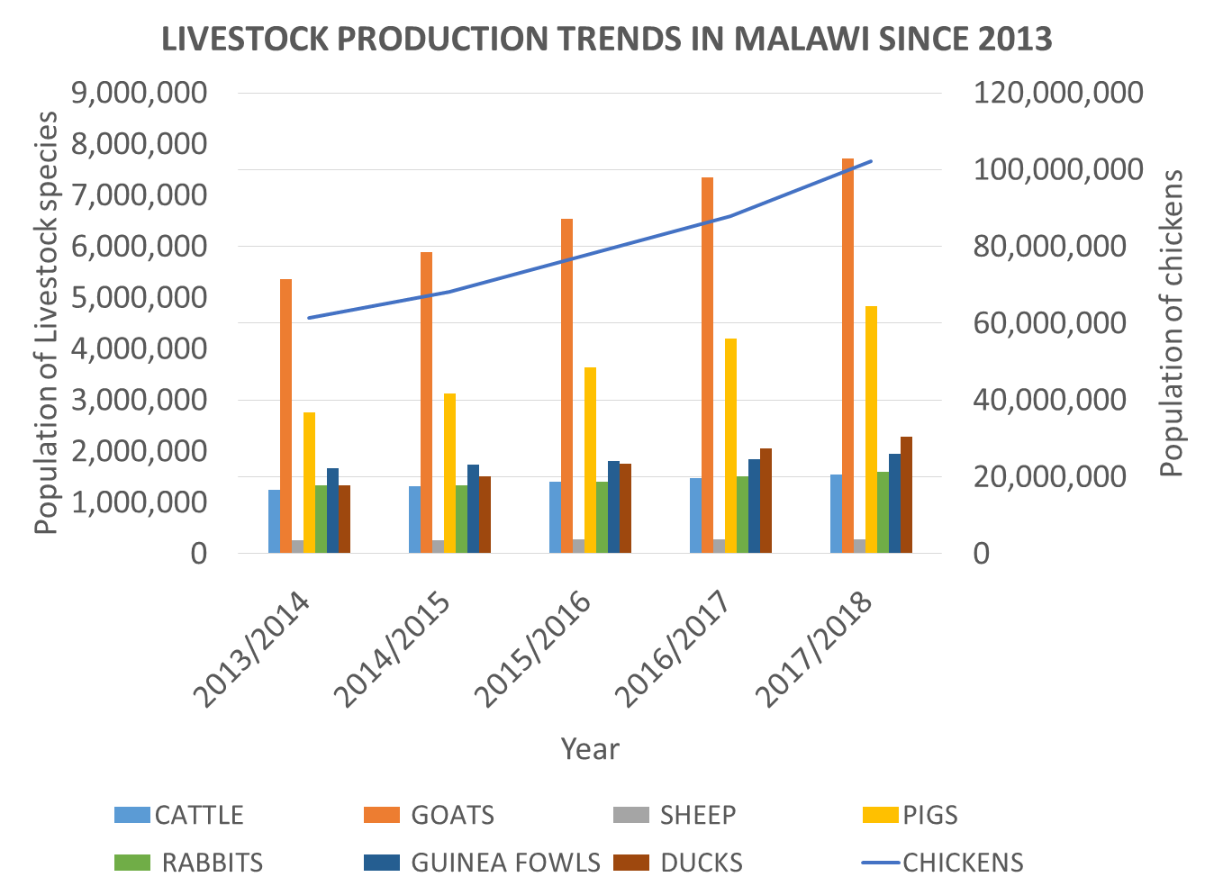

Slide 27
Overview of the animal and allied industries in Malawi
Malawi’s milk consumption is the lowest in Africa at 5litres per capita compared with Africa’s 80litres and the WHO’s recommended intake of 200litres per year (www.export.gov)
In 2013, per capita meat for Malawi was at 7.90kg compared with the average for Africa estimated at 15kg and an average of 41.90kg per capita for the world (FAO, 2013)
Notes:
Fibres categorised depending on their varying colour, which is reflection of myoglobin content. Type 1 fibres appear red due to the high levels of myoglobin. Red muscle fibres have more mitochrondria and greater local capillary density. These muscles are more suited for endurance and are slow to fatigue because they use oxidative metabolism to generate ATP. Less oxidative type II fibres are white due to relatively low myoglobin and reliance ob glycolytic enzymes.

Slide 28
Overview of the animal and allied industries in Malawi
Dairy Industry
The smallholder dairy is concentrated around the major cities of Blantyre, Lilongwe, Zomba and Mzuzu.
Dairying also being done in other districts e.g. Mchinji
Common dairy breeds in Malawi are Holstein Friesian and Jersey
There are 3 dairy associations in Malawi:
Mpoto Dairy Farmers Association (MDFA)
Central Region Milk Producers Association (CREMPA)
Shire Highlands Milk Producers Association (SHMPA)
Notes:
Why is dairying vibrant in peri-urban areas?
Proximity to AI services
Availability of land and pastures
Readily available market
The major differentiating features between smallholder and large-scale dairy farms are the holding size, the genotype of cattle raised and the level of management applied.

Slide 29
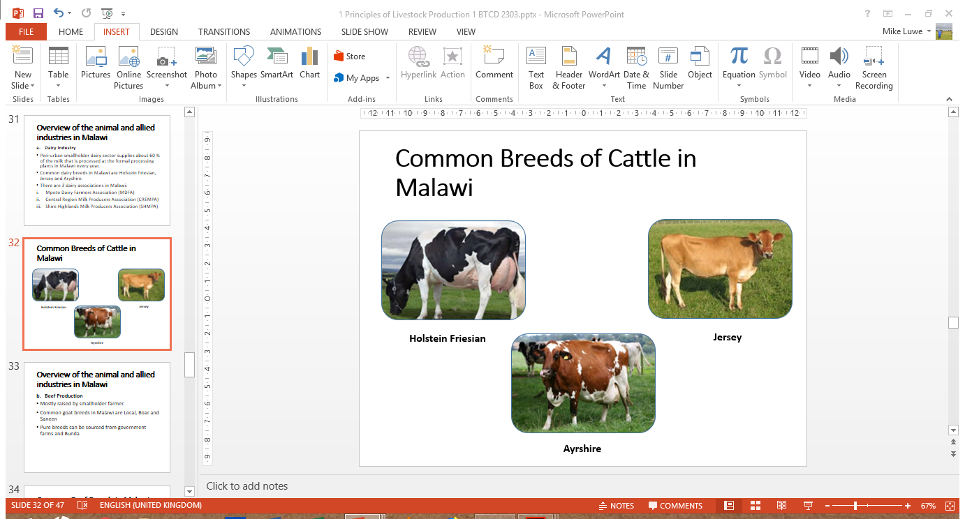
Common Dairy Breeds of Cattle in Malawi
Holstein Friesian
Jersey

Slide 30
Dairy Processing
Dairy processing in Malawi is very limited in scale and extent. It stands between the farmers and their Milk Bulking Groups (MBGs) and the formal distribution system which ranges from street vendors to multiple retailers.
There are basically three types of processor:
Commercial Dairies
Privately owned small scale dairies
Micro processors
During the last decade attempts have been made in Malawi by Non Governmental Organizations to encourage the dissemination of improved technologies on credit
Notes:
Commercial Dairies – these enterprises primarily draw milk from MBGs e.g. Dairiboard Malawi Ltd
Privately owned small scale dairies - which utilise milk from their own dairy cow herds or a limited number of MBGs e.g. Katete Dairy Farm in Lilongwe
Micro processors – which are very limited in number and process milk from smallholder farmers and are managed by the farmers themselves.

Slide 31
Overview of the animal and allied industries in Malawi
Beef Production
The majority of beef cattle raised under smallholder system of production.
Few commercial farmers involved in feedlotting
Government farms act as a source of some improved breeds
Common beef breeds in Malawi are Malawi Zebu, Brahman, Bonsmara and Boran.
Hides are the only animal product being exported

Slide 32
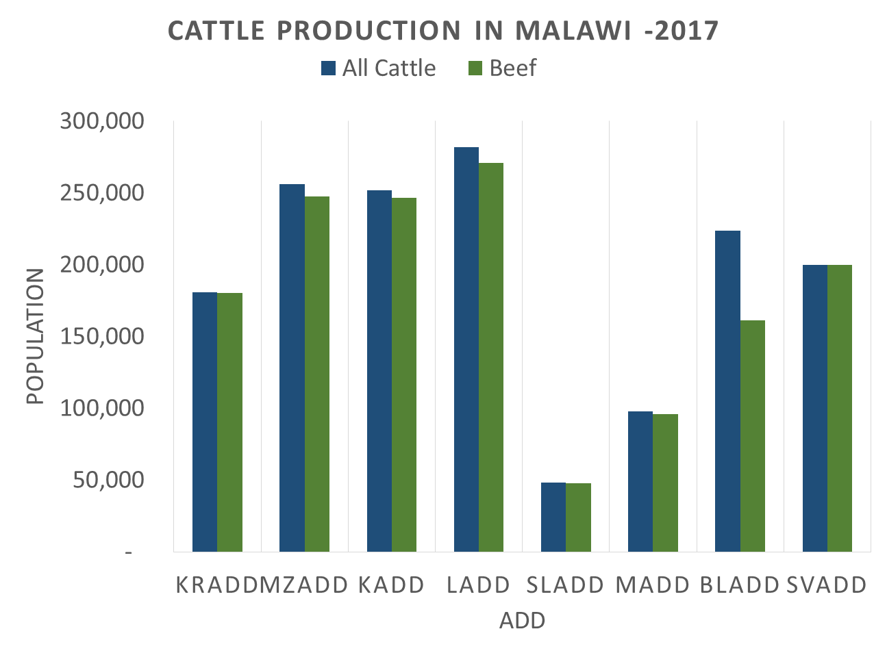

Slide 33
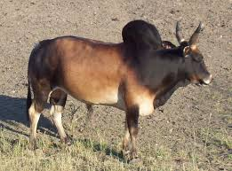
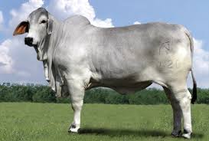
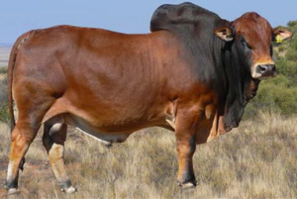
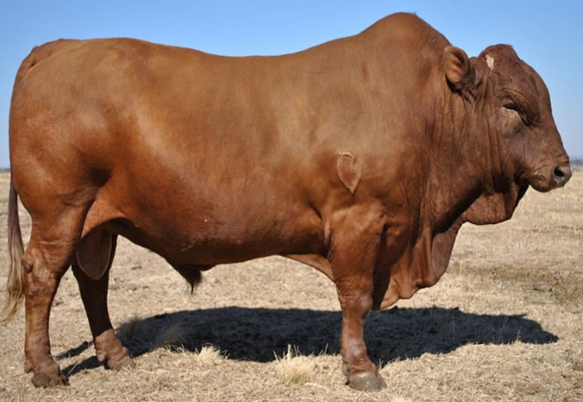
Common Beef Breeds of Cattle in Malawi
Malawi Zebu
Brahman
Boran
Bonsmara

Slide 34
Overview of the animal and allied industries in Malawi
Sheep and Goat Production
Mostly raised by smallholder farmer.
Common goat breeds in Malawi are Local (Small East African), Boer, Alpine and Saneen
Boer goat is mostly used for meat while Alpine and Saneen breeds are for milk
Sheep breed which are common in Malawi are Local (African Long Fat tailed) and Dorper.
There has been a number of smallstock projects aimed at improving smallholder’s livelihoods.
Notes:
Why is dairying vibrant in peri-urban areas?
Proximity to AI services
Availability of land and pastures
Readily available market
The major differentiating features between smallholder and large-scale dairy farms are the holding size, the genotype of cattle raised and the level of management applied.

Slide 35
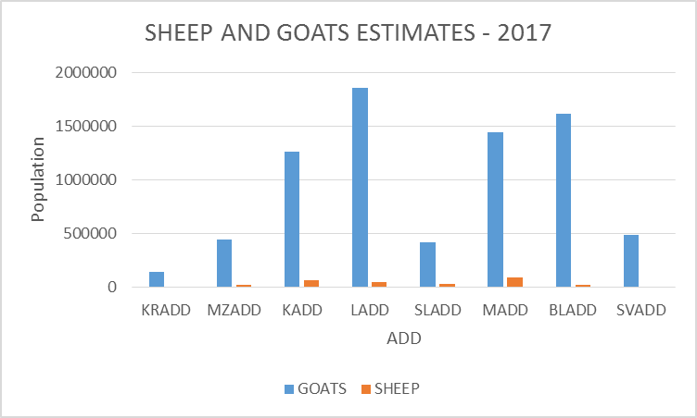
Source: DAHLD, 2017 APES Report

Slide 36
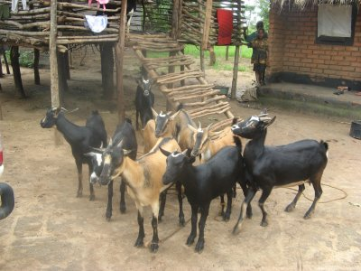
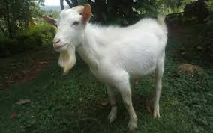
Common Goat Breeds in Malawi
Local breed
Boer
Saneen

Slide 37
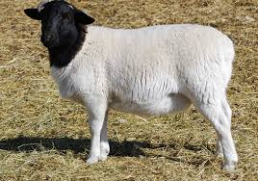
Common Breeds of Sheep in Malawi
Local
Dorper

Slide 38
Overview of the animal and allied industries in Malawi
Poultry Industry
The genesis of commercial poultry production in Malawi can be traced way back in the early 1970s.
The common breeds in Malawi are:
Local
Hyaline
Cobb
Ross
Black Australorp (Mikolongwe)
Notes:
Why is dairying vibrant in peri-urban areas?
Proximity to AI services
Availability of land and pastures
Readily available market
The major differentiating features between smallholder and large-scale dairy farms are the holding size, the genotype of cattle raised and the level of management applied.

Slide 39
Overview of the animal and allied industries in Malawi
Pig Industry
Common pig breeds are local, Landrace, Large White and Tristar.
Inbreeding and poor feeding have negatively affected the performance of the improved breeds.
The other challenge has been African Swine Fever outbreaks.
Notes:
Why is dairying vibrant in peri-urban areas?
Proximity to AI services
Availability of land and pastures
Readily available market
The major differentiating features between smallholder and large-scale dairy farms are the holding size, the genotype of cattle raised and the level of management applied.

Slide 40
Drivers to growth in livestock populations
Some of the key drivers to growth in livestock populations include:
Increasing human population
Increased urbanisation
Increased household income that induces demand for livestock products
Increased NGOs involvement in implementing livestock projects
Existence of a livestock policy that provides direction for livestock development

Slide 41
Limitations/Constraints to Livestock Productivity
Inadequate and high cost of feed
Parasites and diseases
Unavailability of breeding stock due to limited supply of quality breeding stock and slaughter of breedable stock
Inadequate human capacity
Limited regulatory services
Inadequate coordination and networking
Inadequate capital
Theft
Poor marketing system
Reduced land holding sizes / land tenure

Slide 42
Prospects for Improvement
Availability of labour
New technologies development
Integrated farming system of crop and livestock
Increased demand for the livestock and livestock products due to the ever increasing human population

Slide 43
Key concepts and techniques in livestock management
Housing
Feeding
Breeding
Identification
Record keeping
Disease prevention and control
Animal welfare

Slide 44
Key concepts and techniques in livestock management
Housing
Housing is a essential for maintaining health, comfort and protection in order to get maximum productivity from the livestock.
The exact design depends on the species reared, intended use, the local environmental conditions, capital, and a range of other factors.
Animals that can exercise their natural species-specific movements and behaviour patterns as far as possible are less likely to be stressed or injured and will therefore be more productive.
Notes:
Important to preserve the comfort and well-being of the animal
Many other factors, such as feeding, thermal environment, management, construction and economics, can be equally or even more important in the practical design of an animal production system and any buildings involved.

Slide 45
Factors to consider when selecting a site for livestock management
Consider the following when selecting of site:
Topography and Drainage
Soil Type
Water Supply
Accessibility
Labour
Marketing
Electricity
Ventilation
Thermo-comfort zone
The design of the structures should also take into account the animals behaviour
Types of animal housing:
Conventional barns
Loose housing
Free Ranges
Notes:
Instead they are forced to resort to an environment created by humans.

Slide 46
Key concepts and techniques in livestock management
Feeding
Animal feeding stuff can be classified as:
Roughages – dry or succulent
Concentrates – animal or vegetable source
Additives
Different feeding methods can be employed depending on management system e.g. cut–and–carry, tethering, restricted feeding, free range

Slide 47
Key concepts and techniques in livestock management
Breeding
Animal Breeding is the application of genetic principles to the improvement of farm animals.
Breeding is defined as the crossing of the male and female parents to get the offspring for the characters desired.
Animals can mate naturally or be artificially inseminated; and two basic systems of breeding used:
Straight-breeding – mating animals of the same breed.
Cross-breeding – mating of two animals from different breeds.

Slide 48
Key concepts and techniques in livestock management
Breeding
Purebred breeding
Inbreeding
Outcrossing, and
grading up
Straight-breeding
Two-breed crosses
Three-breed crosses, and
Rotation breeding
Cross-breeding
Notes:
Grading up is the mating of purebred sires to grade females. The mating of purebred sires with these grade animals is a good way to improve the quality of animals on the farm.

Slide 49
Straight Breeding
Purebred breeding is the mating of animals within the same breed whose parents can be traced to the same breed.
Inbreeding is the mating of closely related animals.
Outcrossing is the mating of animals of different families within the same breed. The animals bred do not have a common ancestor.
Grading up is the mating of non-descript females and their offspring from generation to generation with sires of the exotic breed.
Cross-breeding
Crossbreeding usually results in improved traits in the off-spring. The resulting offspring is a hybrid.
Dominant genes tend to mask undesirable recessive genes and the resulting superior traits are called Hybrid vigor or heterosis.
Notes:
There is a tendency for purebred animals to be genetically homozygous.
Linebreeding and closebreeding refer to how closely related the animals are that are being mated.
The most intensive form of inbreeding is closebreeding, in which the animals being mated are very closely related and can be traced back to more than one common ancestor.
Linebreeding refers to matings of animals that are more distantly related and can be traced back to one common ancestor. Examples are cousins, grandparent to grandoffspring, or half-brother to half-sister
Most matings done by purebred breeders are outcrossing. This system is popular because it reduces the chances of undesirable traits appearing
in the off spring. The genes for those undesirable traits are still present. However, they are covered up by the outcrossing.

Slide 50
Kinds of cross breeding
Two-Breed Rotation. Bulls from breed A are crossed with cows from breed B. The resulting heifers are bred to bulls from breed B for the duration of their productive life. Replacement heifers chosen from these matings are bred to bulls from breed A. Each succeeding generation of replacement heifers is bred to a bull from the opposite breed used to sire the replacement heifer.
Three-Breed Rotation. The pattern of breeding is the same as in a two-breed system, except that a bull from a third breed is used in the rotation of sires.
Four- and Five-Breed Rotations. In larger herds, bulls from a fourth or fifth breed may be used in the rotation of sires. This system requires a higher level of management than two- and three-breed systems.
Notes:
Superior traits that result from crossbreeding are called hybrid vigor, or heterosis.
Heterosis is measured by the average superiority of the hybrid offspring over the average of the parents. The kind and degree of superiority achieved by
crossbreeding varies with different species.
Animals selected for use in a crossbreeding program must have the desired traits. There will be little or no improvement in the off spring over the parents if animals with undesirable traits are used in a crossbreeding program.
Inbreeding increases the genetic purity of the livestock but generally reduces performance. Both desirable and undesirable traits become more visible.
Therefore, inbreeding programs require careful selection and culling of breeding stock. Inbreeding is not commonly used by the average livestock producer. It is usually used by those who do experimental work to improve the breed.
Outcrossing brings genetic traits into the breeding program that tend to hide undesirable traits. Grading up is using purebred sires on grade females. Grading up is a good way for commercial producers to improve grade herds of livestock.

Slide 51
Identification
Livestock identification essentially refers to the combination of the identification and registration of an animal individually, with a unique identifier, or collectively by its epidemiological unit or group, with a unique group symbol or identifier.
Livestock Identification System (LIS) is important because it promotes control of animals and ensures traceability.
LIS can be classified into 3:
Mechanical e.g. ear tags, paint marks, ear notching
Biological e.g. nose imprints
Electronic e.g. microchip implants
an epidemiological unit refers to a group of animals with a defined relationship that share approximately the same likelihood of exposure to a pathogen. This may be because they share a common environment (e.g. animals in a pen), or because of common management practices.
Electronic e.g. Rumen Boluses Radio Frequency Identification Devices (RFID)

Slide 52
Record keeping
In order to maintain records, all animals must be identified using an agreed identification method.
Different types of records kept on a farm
Examples of types of farm records are:
Individual animal records
Milk Production records
Reproduction records
Financial records
Functions of records:
They are used as a service tool e.g. managing credit
Provides efficiency indicators of the livestock business enterprises – monitoring progress
They provide data for financial analysis and other diagnostic instruments
Planning tool – past records used to project the future

Slide 53
Disease Prevention and Control
Various measures can be instituted to prevent diseases at a farm.
Vaccination, deworming, good plane of nutrition, dipping, biosecurity and proper housing are crucial in disease prevention and control.
Curative and supportive therapy can be given whenever an animal is diseased but this depends on the disease being dealt with. Certain diseases require destruction
Prevention means all the measures taken to stop disease or problems before they occur, while treatment means the actions taken to cure or control a disease after animals are already sick.
Prevention
Focuses on keeping animals healthy through vaccination, biosecurity, good housing, balanced feeding, hygiene, and regular deworming.​
Reduces the need for medicines (especially antibiotics), lowers costs in the long run, improves productivity, and helps avoid drug resistance.​
Treatment
Applies only when disease is present, using drugs (e.g. antibiotics, dewormers), surgery, or other veterinary procedures to restore health.​
Is usually more expensive, may not fully restore performance, and if drugs are misused can lead to residues in animal products and antimicrobial resistance.
Notes:
BIOSECURITY
3 Components:
1. Isolation
2. Traffic control
3. Sanitation

Slide 54
Animal Welfare
Animal welfare is defined as ‘how an animal is coping with the conditions in which it lives’. (OIE)
Good animal welfare requires disease prevention and veterinary treatment, appropriate shelter, management, nutrition, humane handling and humane slaughter
Five freedoms:
Freedom from thirst and hunger
Freedom from discomfort
Freedom from pain, injury, and disease
Freedom to express normal behaviour
Freedom from fear and distress

Slide 55
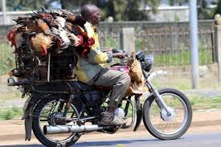
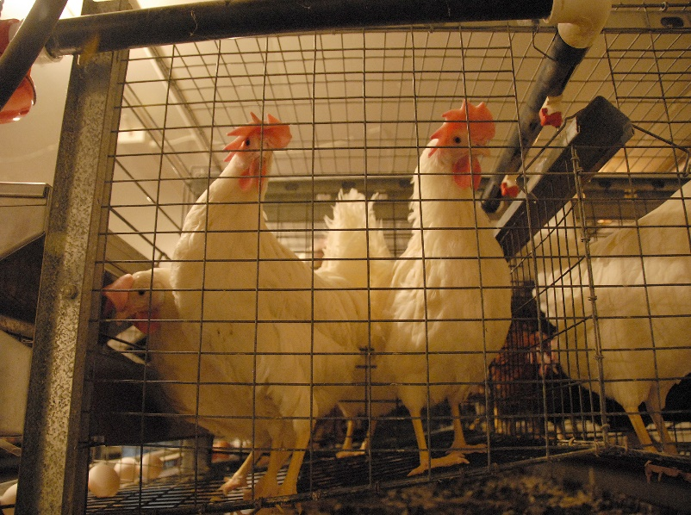
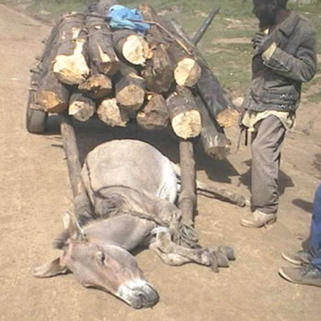
7. Animal Welfare

Slide 56
Key summary of concepts and techniques in livestock management
Housing
Feeding
Breeding
Identification
Record keeping
Disease prevention and control
Animal welfare

